Slide 1
Linear correlation and linear regression

Slide 2
Continuous outcome (means)
Outcome Variable | Are the observations independent or correlated? |  | Alternatives if the normality assumption is violated (and small sample size):
 | independent | correlated
Continuous (e.g. pain scale, cognitive function) | Ttest: compares means between two independent groups ANOVA: compares means between more than two independent groups Pearson’s correlation coefficient (linear correlation): shows linear correlation between two continuous variables Linear regression: multivariate regression technique used when the outcome is continuous; gives slopes | Paired ttest: compares means between two related groups (e.g., the same subjects before and after) Repeated-measures ANOVA: compares changes over time in the means of two or more groups (repeated measurements) Mixed models/GEE modeling: multivariate regression techniques to compare changes over time between two or more groups; gives rate of change over time | Non-parametric statistics Wilcoxon sign-rank test: non-parametric alternative to the paired ttest Wilcoxon sum-rank test (=Mann-Whitney U test): non-parametric alternative to the ttest Kruskal-Wallis test: non-parametric alternative to ANOVA Spearman rank correlation coefficient: non-parametric alternative to Pearson’s correlation coefficient

Slide 3
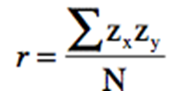

Recall: Covariance
Covariance is unit dependent. i.e. If we multiply x or y by some constant, covariance also gets multiplied by same constant.
This problem can be handles easily. We know Standard deviation also shows similar behavior.. So, the standard deviations can be used to “normalize” the covariance such that
cov(X,Y) > 0 X and Y are positively correlated
cov(X,Y) < 0 X and Y are inversely correlated
cov(X,Y) = 0 X and Y are independent
Pearson’s Correlation Coefficient
Measures the relative strength of the linear relationship between two variables
Unit-less and Ranges between –1 and 1
The closer to –1, the stronger the negative linear relationship
The closer to 1, the stronger the positive linear relationship
The closer to 0, the weaker any positive linear relationship
This standardized covariance (unitless) is called Pearson’s Correlation Coefficient

Slide 4
Scatter Plots of Data with Various Correlation Coefficients
Y
Y
Y
r = -1
r = -.6
r = 0
X
X
X
Y
Y
Y
r = +1
r = +.3
r = 0
X
X
X

Slide 5
Linear Correlation
Linear relationships
Curvilinear relationships
Y
Y
X
X
Y
Y
X
X

Slide 6
Linear Correlation
Strong relationships
Weak relationships
No relationship
Y
Y
Y
X
X
X
Y
Y
Y
X
X

Slide 7
Calculating by hand…

Slide 8
Simpler calculation formula…
Numerator of covariance
Numerators of variance

Slide 9
Distribution of the correlation coefficient:
The sample correlation coefficient follows a T-distribution with n-2 degrees of freedom (since you have to estimate the standard error).
*note, like a proportion, the variance of the correlation coefficient depends on the correlation coefficient itself→substitute in estimated r

Slide 10
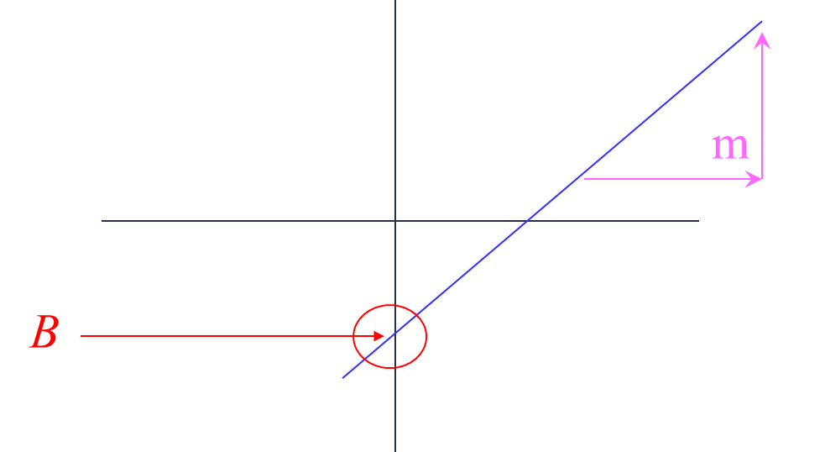
Linear regression
In correlation, the two variables are treated as equals.
In regression, one variable is considered independent (=predictor) variable (X) and the other the dependent (=outcome) variable Y.
Remember this:
Y=mX+B?
A slope of 2 means that every 1-unit change in X yields a 2-unit change in Y.

Slide 11
Prediction
If you know something about X, this knowledge helps you predict something about Y. (Sound familiar? )
…sound like conditional probabilities?

Slide 12
Regression equation…
Expected value of y at a given level of x=

Slide 13
Predicted value for an individual…
α + β*x_{i}
yi=
+
random error_{i}
Fixed – exactly on the line
Follows a normal distribution

Slide 14
Assumptions (or the fine print)
Linear regression assumes that…
The relationship between X and Y is linear
Y is distributed normally at each value of X
The variance of Y at every value of X is the same (homogeneity of variances)
The observations are independent

Slide 15
Standard error
The standard error of Y given X is the average variability around the regression line at any given value of X. It is assumed to be equal at all values of X.
Sy/x
Sy/x
Sy/x
Sy/x
Sy/x
Sy/x

Slide 16
Regression Picture
y_{i}
C
A
B
y
B
A
C
*Least squares estimation gave us the line (β) that minimized C²
y_{i}
x
R²=SSreg/SStotal
A² B² C²
SS_{total}
Total squared distance of observations from naïve mean of y
Total variation
SS_{reg}
Distance from regression line to naïve mean of y
Variability due to x (regression)
SS_{residual}
Variance around the regression line
Additional variability not explained by x—what least squares method aims to minimize

Slide 17
Estimating the intercept and slope: least squares estimation
** Least Squares Estimation
A little calculus….
What are we trying to estimate? β, the slope, from
What’s the constraint? We are trying to minimize the squared distance (hence the “least squares”) between the observations themselves and the predicted values , or (also called the “residuals”, or left-over unexplained variability)
Differencei = yi – (βx + α) Differencei² = (yi – (βx + α)) ²
Find the β that gives the minimum sum of the squared differences. How do you maximize a function? Take the derivative; set it equal to zero; and solve. Typical max/min problem from calculus….
From here takes a little math trickery to solve for β…

Slide 18

Resulting formulas…
Slope (beta coefficient) =
As
Intercept=
Regression line always goes through the point:

Slide 19
Relationship with correlation
In correlation, the two variables are treated as equals. In regression, one variable is
considered independent (=predictor) variable (X) and the other the dependent (=outcome) variable Y.

Slide 20
Residual Analysis: check assumptions
The residual for observation i, e_{i}, is the difference between its observed and predicted value
Check the assumptions of regression by examining the residuals
Examine for linearity assumption
Examine for constant variance for all levels of X (homoscedasticity)
Evaluate normal distribution assumption
Evaluate independence assumption
Graphical Analysis of Residuals
Can plot residuals vs. X

Slide 21
Residual Analysis for Linearity
Y
Y
x
x
residuals
x
x
residuals
Not Linear
✓
Linear

Slide 22
Residual Analysis for Homoscedasticity
Y
Y
x
x
residuals
x
x
residuals
✓
Non-constant variance
Constant variance
Slide from: Statistics for Managers Using Microsoft® Excel 4th Edition, 2004 Prentice-Hall

Slide 23
Residual Analysis for Independence
Not Independent
✓
Independent
residuals
X
residuals
X
residuals
X
Slide from: Statistics for Managers Using Microsoft® Excel 4th Edition, 2004 Prentice-Hall

Slide 24
Types of variables to be analyzed
Statistical procedure
or measure of association
Predictor variable/s
Outcome variable
Cross-sectional/case-control studies
Binary (two groups)
Continuous
T-test
Binary
Ranks/ordinal
Wilcoxon rank-sum test
Categorical (>2 groups)
Continuous
ANOVA
Continuous
Continuous
Simple linear regression
Multivariate
(categorical and continuous)
Continuous
Multiple linear regression
Categorical
Categorical
Chi-square test (or Fisher’s exact)
Binary
Binary
Odds ratio, risk ratio
Multivariate
Binary
Logistic regression
Cohort Studies/Clinical Trials
Binary
Binary
Risk ratio
Categorical
Time-to-event
Kaplan-Meier/ log-rank test
Multivariate
Time-to-event
Cox-proportional hazards regression, hazard ratio
Categorical
Continuous
Repeated measures ANOVA
Multivariate
Continuous
Mixed models; GEE modeling

Slide 25
Alternative summary: statistics for various types of outcome data
Outcome Variable | Are the observations independent or correlated? |  | Assumptions
 | independent | correlated
Continuous (e.g. pain scale, cognitive function) | Ttest ANOVA Linear correlation Linear regression | Paired ttest Repeated-measures ANOVA Mixed models/GEE modeling | Outcome is normally distributed (important for small samples). Outcome and predictor have a linear relationship.
Binary or categorical (e.g. fracture yes/no) | Difference in proportions Relative risks Chi-square test Logistic regression | McNemar’s test Conditional logistic regression GEE modeling | Chi-square test assumes sufficient numbers in each cell (>=5)
Time-to-event (e.g. time to fracture) | Kaplan-Meier statistics Cox regression | n/a | Cox regression assumes proportional hazards between groups

Slide 26
Continuous outcome (means); HRP 259/HRP 262
Outcome Variable | Are the observations independent or correlated? |  | Alternatives if the normality assumption is violated (and small sample size):
 | independent | correlated
Continuous (e.g. pain scale, cognitive function) | Ttest: compares means between two independent groups ANOVA: compares means between more than two independent groups Pearson’s correlation coefficient (linear correlation): shows linear correlation between two continuous variables Linear regression: multivariate regression technique used when the outcome is continuous; gives slopes | Paired ttest: compares means between two related groups (e.g., the same subjects before and after) Repeated-measures ANOVA: compares changes over time in the means of two or more groups (repeated measurements) Mixed models/GEE modeling: multivariate regression techniques to compare changes over time between two or more groups; gives rate of change over time | Non-parametric statistics Wilcoxon sign-rank test: non-parametric alternative to the paired ttest Wilcoxon sum-rank test (=Mann-Whitney U test): non-parametric alternative to the ttest Kruskal-Wallis test: non-parametric alternative to ANOVA Spearman rank correlation coefficient: non-parametric alternative to Pearson’s correlation coefficient

Slide 27
Binary or categorical outcomes (proportions); HRP 259/HRP 261
Outcome Variable | Are the observations correlated? |  | Alternative to the chi-square test if sparse cells:
 | independent | correlated
Binary or categorical (e.g. fracture, yes/no) | Chi-square test: compares proportions between two or more groups Relative risks: odds ratios or risk ratios Logistic regression: multivariate technique used when outcome is binary; gives multivariate-adjusted odds ratios | McNemar’s chi-square test: compares binary outcome between correlated groups (e.g., before and after) Conditional logistic regression: multivariate regression technique for a binary outcome when groups are correlated (e.g., matched data) GEE modeling: multivariate regression technique for a binary outcome when groups are correlated (e.g., repeated measures) | Fisher’s exact test: compares proportions between independent groups when there are sparse data (some cells <5). McNemar’s exact test: compares proportions between correlated groups when there are sparse data (some cells <5).

Slide 28
Time-to-event outcome (survival data); HRP 262
Outcome Variable | Are the observation groups independent or correlated? |  | Modifications to Cox regression if proportional-hazards is violated:
 | independent | correlated
Time-to-event (e.g., time to fracture) | Kaplan-Meier statistics: estimates survival functions for each group (usually displayed graphically); compares survival functions with log-rank test Cox regression: Multivariate technique for time-to-event data; gives multivariate-adjusted hazard ratios | n/a (already over time) | Time-dependent predictors or time-dependent hazard ratios (tricky!)

